Slide 1
STEM Challenges and Progression at Elrick

Slide 2
STEM at Elrick
https://express.adobe.com/video/qK4TUhZthoUSS

Slide 3
What is a STEM Challenge?
A STEM Challenge is a problem which requires learners to use their skills and knowledge from Science, Technology, Engineering and Maths to design, build, test and improve a solution.
Learners are asked to solve a specific problem with boundaries, using their STEM knowledge and skills, for example:
Build a bridge across a gap – it may have to support a given weight.
Build a boat that can float in water to carry a given weight or object

Slide 4
STEM Challenges Progression

Slide 5
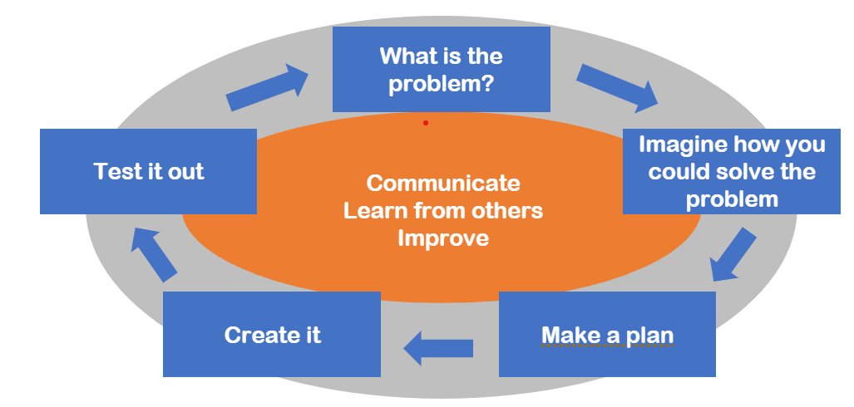
STEM Challenges First Level

Slide 6
STEM Challenges First Level
P3 were challenged to build a structure to allow a small figure to get from the table to the floor.
https://glowscotland.sharepoint.com/:v:/r/sites/ElrickStaff397/Shared%20Documents/General/Session%2022-23/STEM%20Workshop/video-20230208-180052-e37f8d8f.mov?csf=1&web=1&e=th3pK9

Slide 7
STEM Challenges Second Level
Presenter name
Email address
Website address

Slide 8
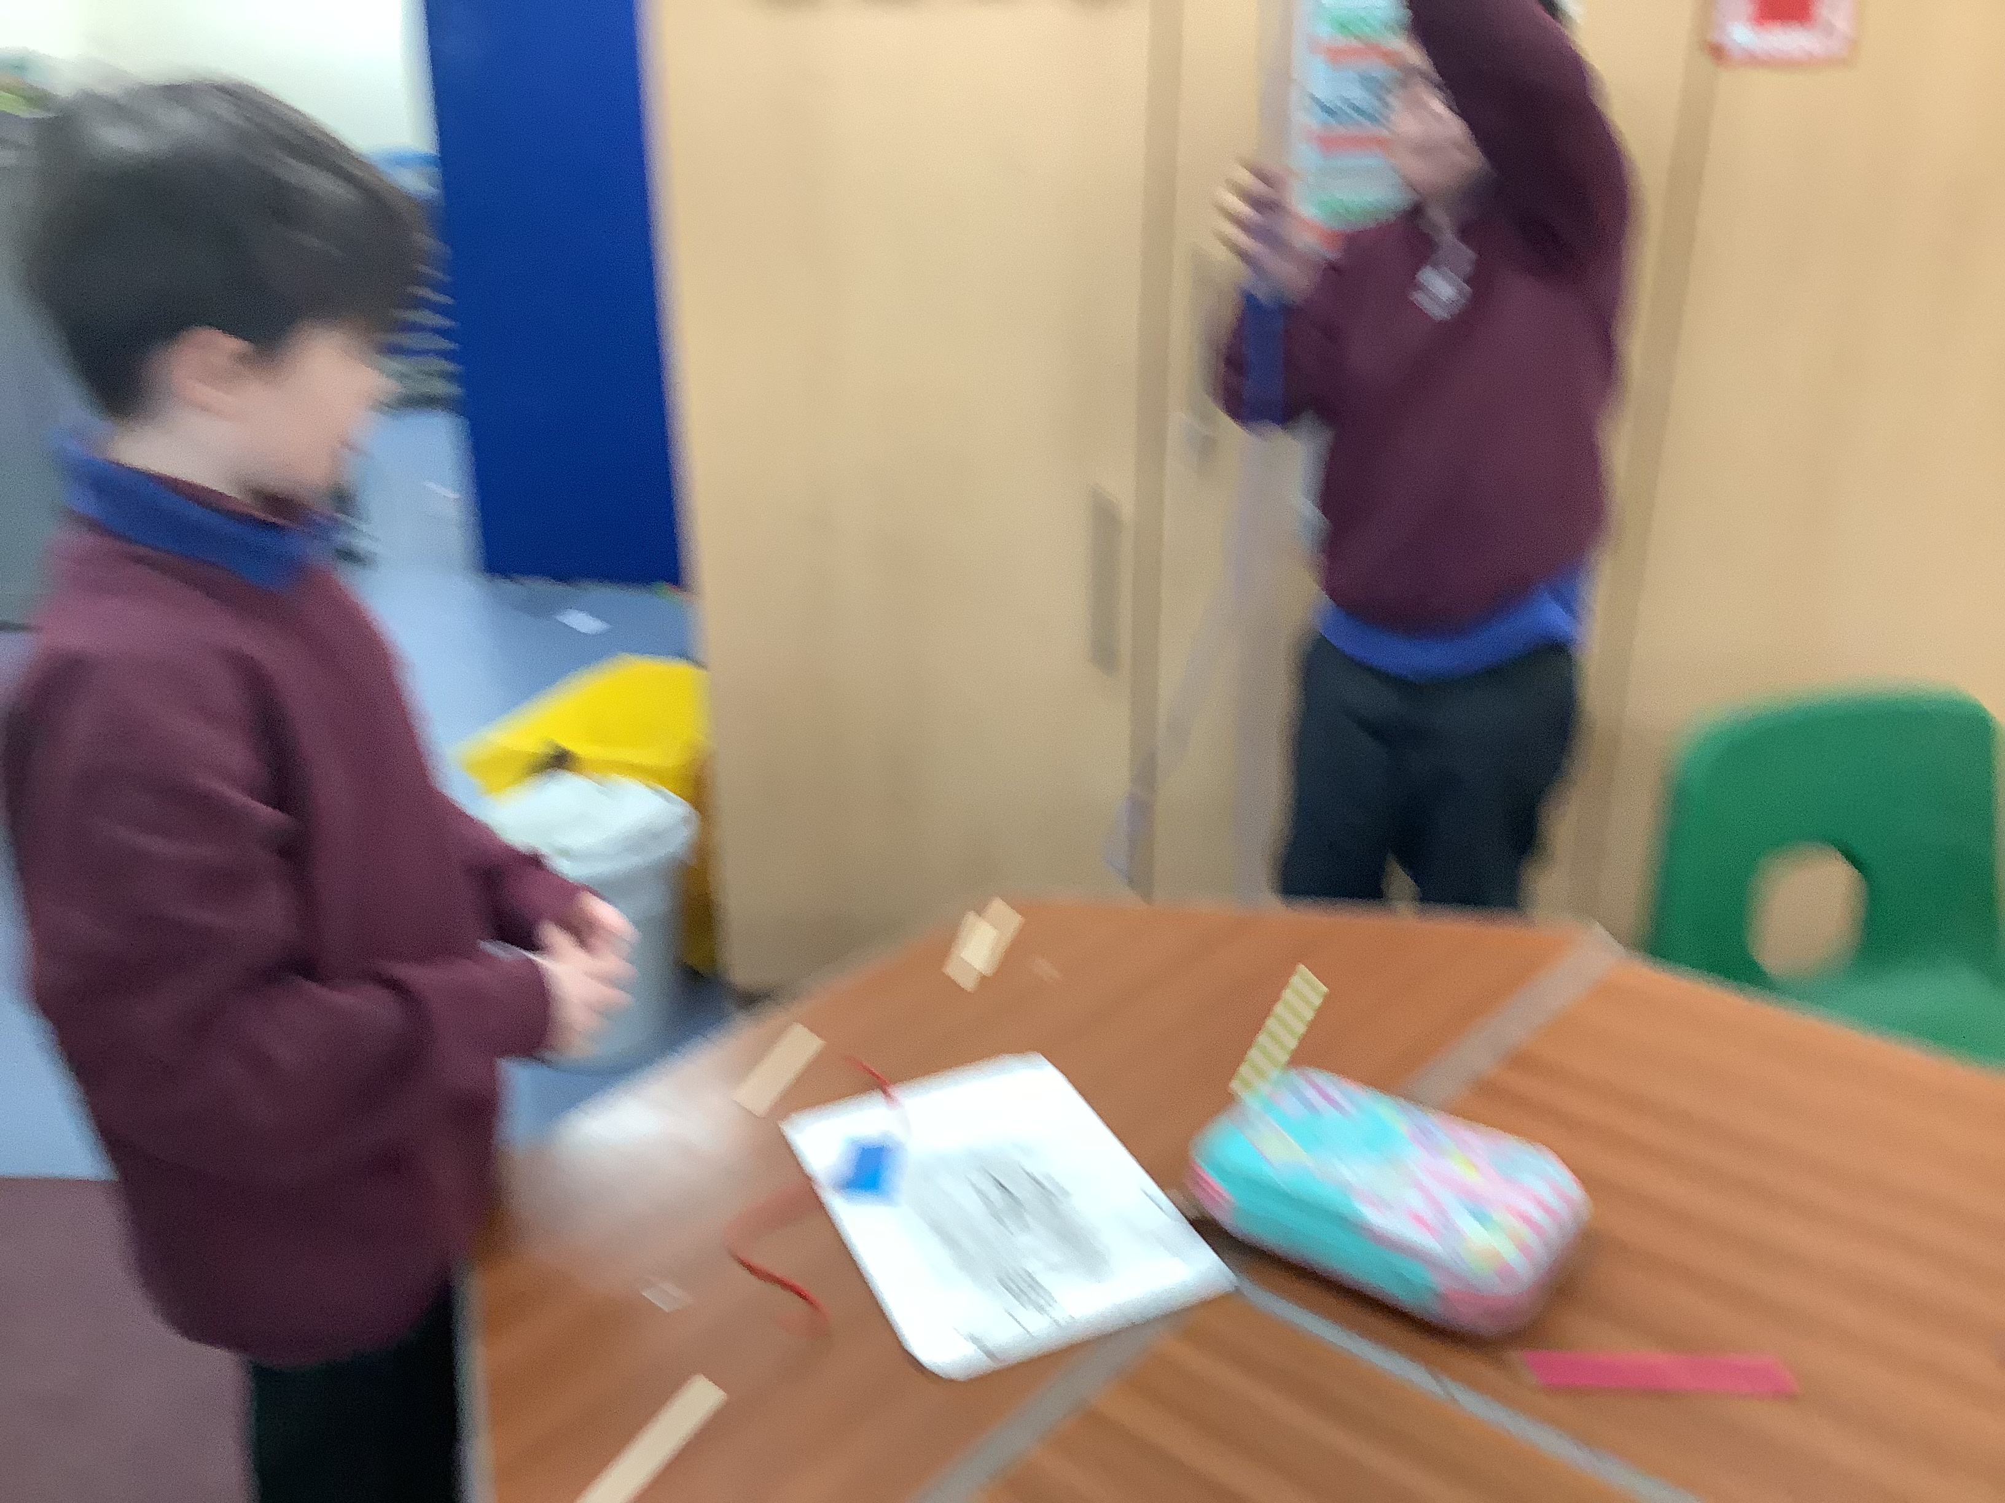
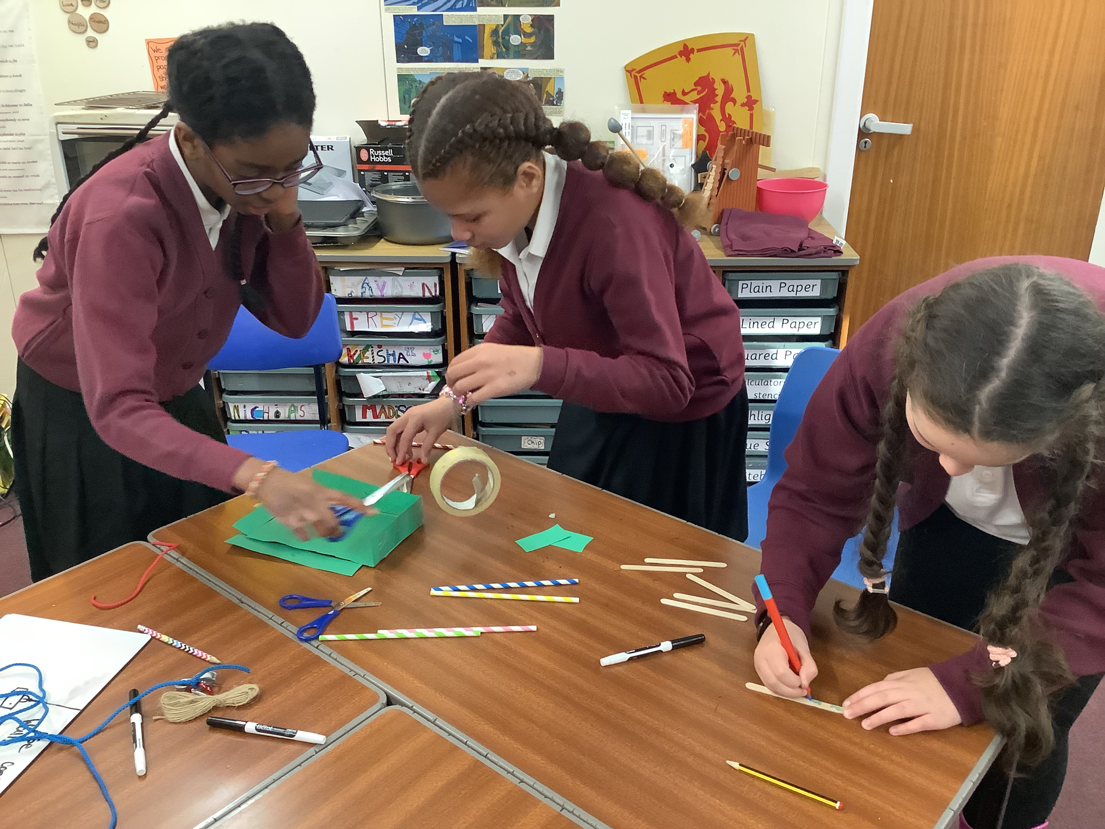
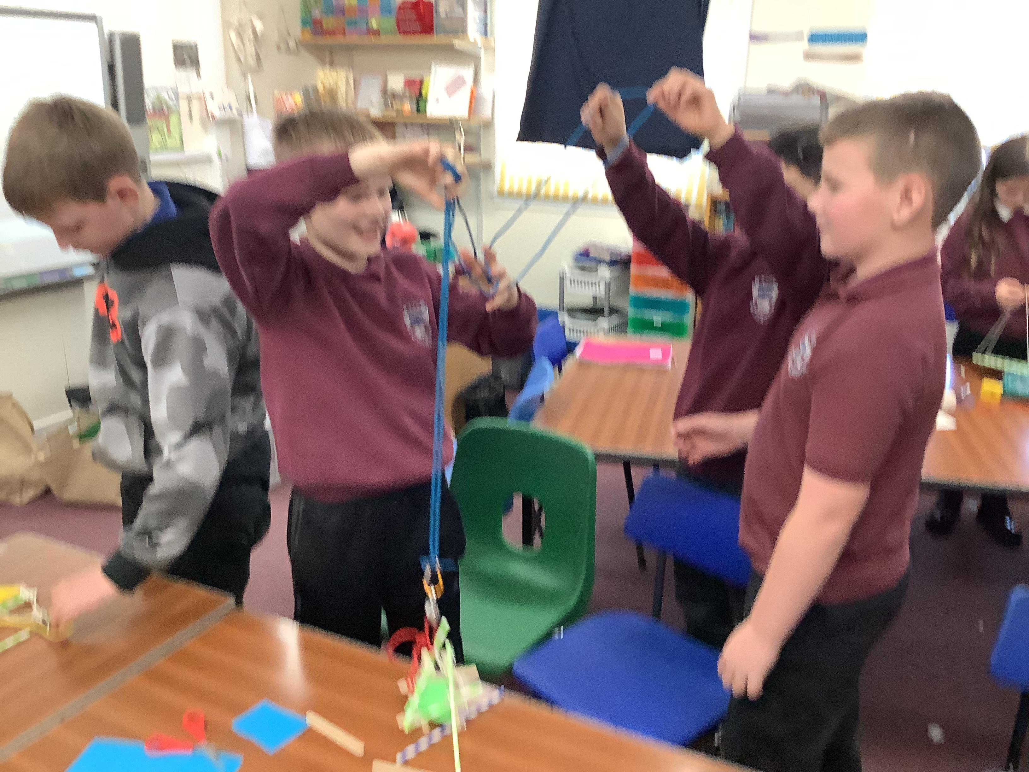
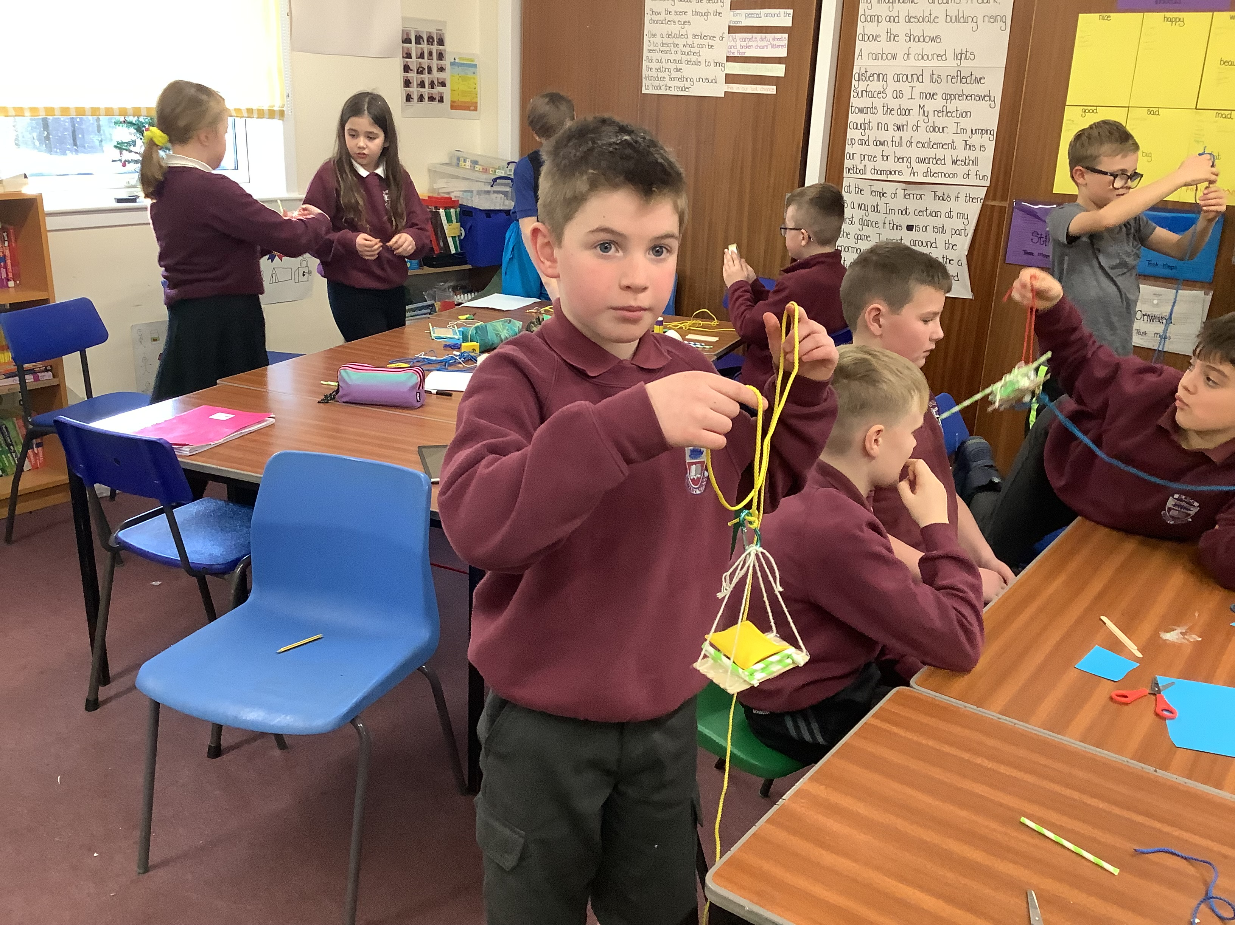
Deeper Learning
Moving beyond remembering and understanding facts and basic concepts
Application of prior learning in different contexts
Analyse, evaluate and create - plan, make prototype, modify from testing.

Slide 9
Test, Evaluate and Modify

Slide 10
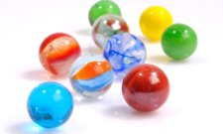
STEM Challenge Marble Run
Design and build a straight marble ramp on your desk​
You must include a marble catcher at the end to stop the marble rolling away​
The challenge is to make the marble take as much time as possible to travel from the start to the marble catcher​
The top of the marble ramp must be less than 10 cm above the desk​
You cannot stick anything to the desk​
No tubes, only ramps – you must be able to see the marble as it travels down​
​
You will be given the following materials:​
2 x A4 paper​
Sellotape​
Marble in a pot (you cannot use the pot)​
​
Test your marble ramp and try to improve it

Slide 11
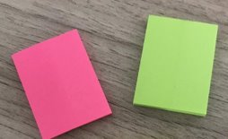
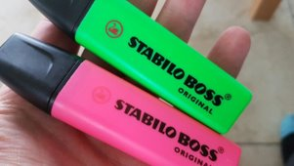
STEM Challenge Marble Run - Evaluation
On a pink post-it, write down what you are Tickled Pink about – what is good about your design?​
On a green post-it, write down what is Green For Growth – what needs to be improved about your design?​
​
Or you could use pink and green highlighters to draw straight on to your design!

Slide 12
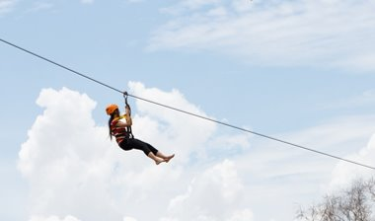
STEM & Outdoor Learning
Zip Lines

