Slide 1

Elrick Primary School
Promoting Positive Relationships,
Support Strategies in School
May 2023

Slide 2
Introduction, Aims and Ethos of the evening
Welcome to everyone ☺
To develop a shared understanding of approaches used to support positive relationships in school
To develop an understanding of the evidence and psychology of support strategies implemented in schools

Slide 3
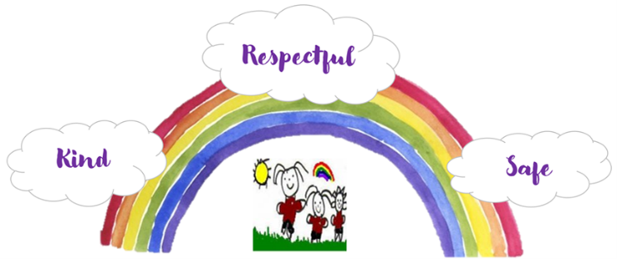
Elrick Primary School
A Happy Place to Learn, Develop and Grow

Slide 4
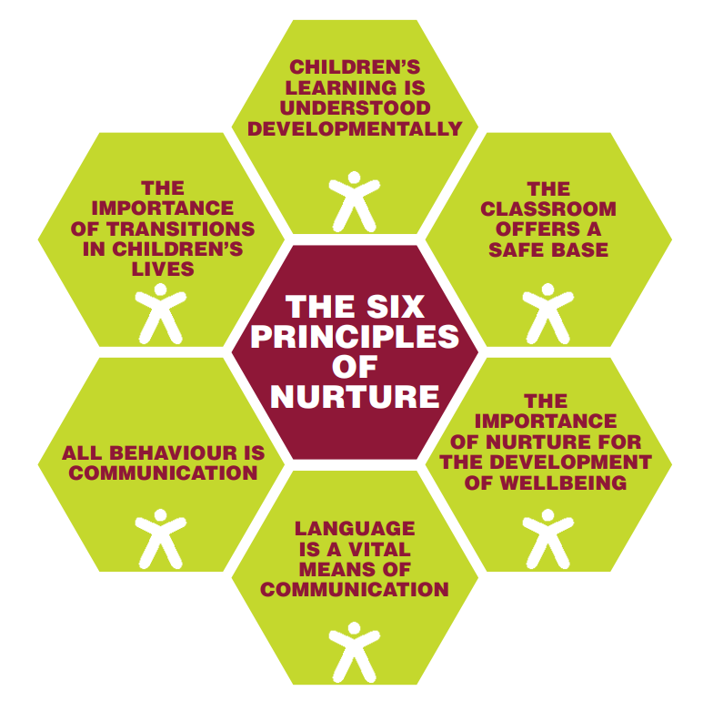
Being a Nurturing School
Notes:
Most staff have now completed ‘Whole School Nurture’ training, exploring the nurture principles, attachment and attunement, relationships and resilience, brain, trauma and stress, and emotion coaching.
The nurture principles underpin our school ethos and inform our practice at whole school, class and individual level.
The diagram in the slide shows these principles but what do they actually mean?
Children’s Learning is understood developmentally – this applies across all stages as teachers plan for children at an appropriate level to meet individual needs, taking into account where the child is developmentally with regards their personal, social, emotional and academic development.
The classroom offers a safe base – trusting relationships are key to children feeling safe in their environment. Routines need to be established and clear boundaries in place – both physical and emotional. When secure relationships are in place, children have increased resilience even when faced with adversity.
The importance of nurture for the development of self-esteem – all staff work hard to ensure that children feel valued and listened to. Staff make time to talk about events and feelings, listening and responding to children’s needs. Positive eye contact, facial expression and tone of voice are encouraged.
Language as a vital means of communication – adults encourage opportunities for language and communication and model good practise, supporting children to make the connection between the action and the language.
All behaviour is communication – staff understand the importance and significance of all communication including non-verbal and physical contact and respond appropriately. A variety of strategies are developed such as distraction and humour in order to respond to behaviour. Undesirable behaviour is treated firmly but not punitively. Children will sense that that as their behaviour is understood rather than judged, difficult situations may be diffused. Staff observe and record behaviour objectively without judgement but with growing understanding. Planned support.
The importance of transitions in children’s lives is understood – transitions are planned and manageable and when possible children are prepared for changes in routine. Out of school transitions are planned, with clear procedures in place, involving parents whenever possible.

Slide 5
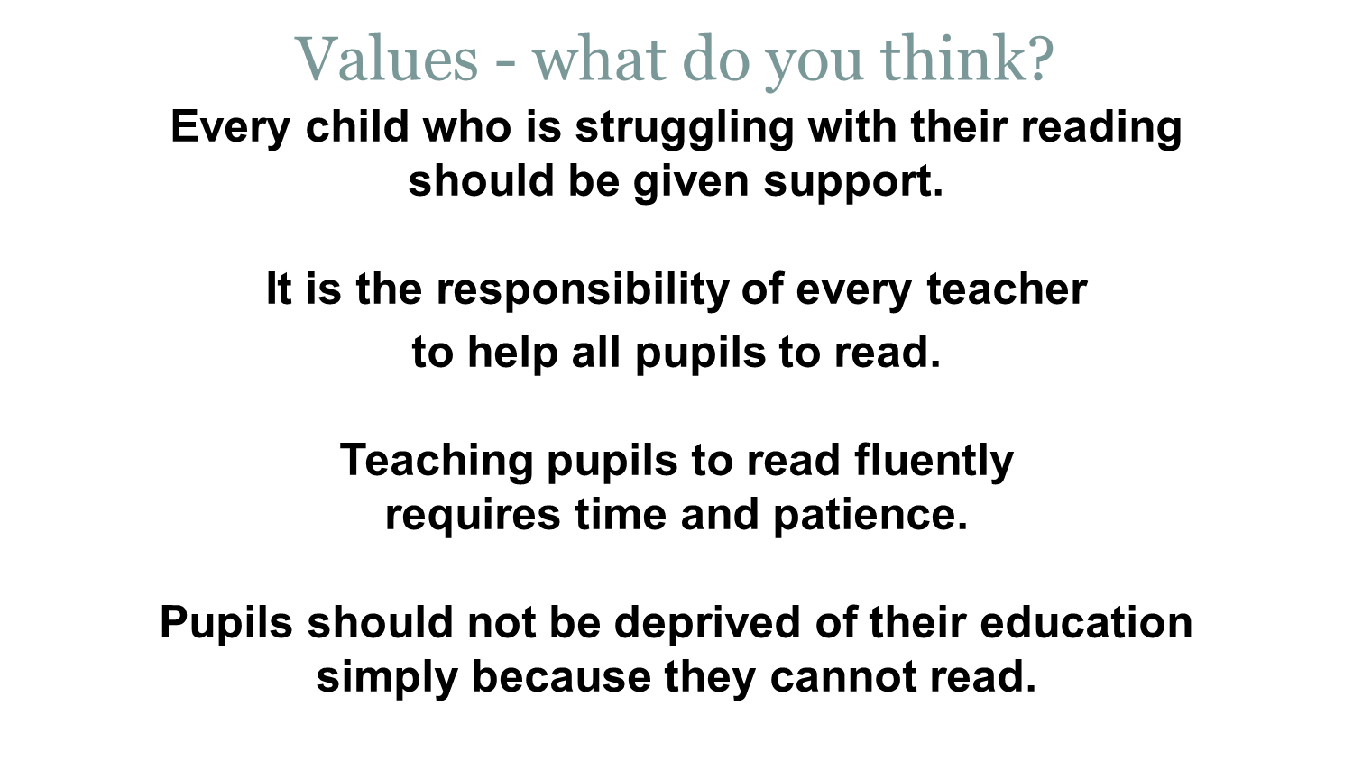
Notes:
Please read the following slide and decide if you agree or disagree with the statements.

Slide 6
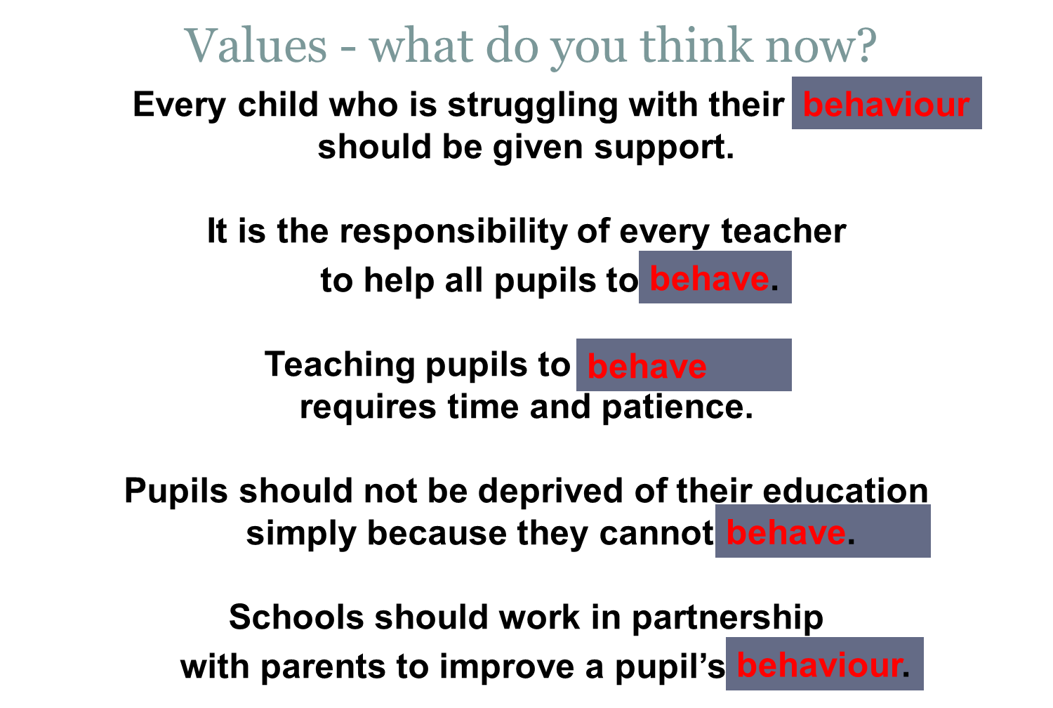
Notes:
Now read this slide. Do you Agree/disagree?
We know that negative behaviour can cause anxiety and upset for pupils, parents and staff. At Elrick School we are committed to doing our best to support children, helping them to regulate their emotions and in turn help prevent inappropriate and unacceptable behaviour. Unfortunately there is no quick fix and change rarely happens overnight.
To help us do this, most staff have engaged in CALM Theory training to raise their awareness of what may be causing the unwanted behaviour and to give them strategies to support de-escalation. All staff have engaged in Respectme’s Anti-Bullying training so that they know the signs to look out for and how they can support children who have experienced bullying behaviour and also help children understand the impact their behaviour may have on others. All staff have also engaged in reading using Paul Dix as a reference, looking at strategies which can be embedded in our practise to encourage positive behaviour and relationships in our school community.

Slide 7
Approaches to Managing Behaviour
Behaviours | Possible Response/Action
Stage 1 Low level, disruptive behaviours, which are beginning to impact on the rights of others | Restorative discussion/Circle Time discussions • Universal Support (quiet area, time out/in, de-escalation, emotion coaching, zones of regulation)
Stage 2 Repeated unacceptable behaviours/language (including consistent low level behaviours) after restorative approaches have been put in place but not had desired effect Disruptive behaviour which is having a notable impact on the rights of others | Restorative Discussion • Contacting Parents/Carers • SLT Involvement • School-based meeting with parents/carers • Targeted support
Stage 3 Ongoing unacceptable behaviours/language Disruptive/disrespectful behaviour which is having a significant impact on the rights of others (children/adults) Discriminatory behaviours, language or actions Severe, intentional physical contact Theft/Vandalism A sudden, unexpended, serious incident Bullying behaviours | * Restorative Discussion • GIRFEC meetings (may be Multi-Agency I involving other professionals) Behaviour Risk Assessment and Action Plan • Aberdeenshire's Bullying Staged Guidance • Exclusion
Notes:
Stage 1 – Low level disruptive behaviour may include
Off task
Continuous chatting in class
Time wasting
Not listening
Shouting out
Poor manners
Name calling
Use of inappropriate language

Slide 8
Support routes
Additional Support for Learning staff – academic, social and emotional
Counsellor
Intervention and Prevention Teacher
Educational Psychologist
School nurse and school doctor
Kooth
Medical Professionals/Social Workers
Notes:
There are various different support routes available for children and young people which are widely accessed by us in school when supporting children who have been impacted by bullying behaviour or involved in bullying. The arrows in the slide are not there to represent any specific order in which support may be accessed.

Slide 9

Michelle O’Grady
Educational Psychologist

Slide 10
Discipline
The root word for discipline is disciple, from old French, meaning learner. In the verb form, it means to guide, lead, teach, model and encourage.
We are moving away from the traditional view of rewarding good behaviour and punishing bad behaviour and moving towards a relational/developmental based behaviour model.
Differentiation discipline/support which is informed by the child’s developmental and emotional regulatory stage.
Notes:
We now know so much more about human brain development and as a result we continue to develop our understanding of how to support children and young.
When a baby is born nearly all the cells in the brain are present but they are not working yet. They start working when connections are made between cells in response to what they experience. Babies need adults to soothe and stimulate them in order to build their brains and develop loving secure attachments. Their brain is a social organ, it works best when it is linked into other brains through interaction. Neuroscience shows that what happens to us shapes our brains.
This evening I am going to talk through some of the strategies that we use in schools to support healthy brain development.
First I want us to think about the word discipline and what this means in terms of how we support children.

Slide 11
Punishment (Traditional) can lead to:
Fear
Resentment
Hostility / Aggression
A ‘don’t get caught’ attitude
Short term compliance
Adversarial attitude
Sense of ‘injustice’
The main purpose of punishment is not to bring about change in behaviour but to inflict pain on a person for breaking the rules
Discipline (Restorative) can lead to:
Respect / positive regard
Improved relationships
Trust
Enhanced self-control
Self regulation
Learning
Confidence
Ability / efficacy in seeking and finding solutions
Long-term change
The main purpose of discipline is to train by practice, especially to enable self control and positive regard. Discipline requires time, patience and a good sense of humour.
Notes:
Here we can see the difference between the traditional punishment approach, and the restorative approach.
Which one will support emotional regulation and brain development?
Remember our brains seek social connections
Bessel Van der Kolk , Psychiatrist & educator (The Body Keeps the Score) quote, Angry confrontations and punishment can at best temporarily halt unacceptable behaviours, but since the underlying alarm system and stress hormones are not laid to rest, they are certain to erupt again at the next provocation.

Slide 12
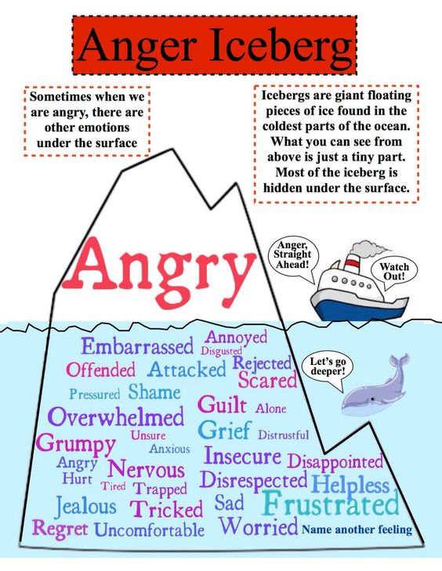

What is driving the behaviours we see?
Notes:
As you know all too well, one of the most problematic emotions to support, both in school and home, in both children, young people and adults, is anger. You may have seen this picture before or something like it.
Approaches to supporting YP with very challenging behaviour tend to revolve around emotional literacy and giving YP words/language to express emotions appropriately. This is a really important part of the story but only part of it…
Our understanding of what drives anger, as an example, is often explained by other feelings…but what drives those….

Slide 13

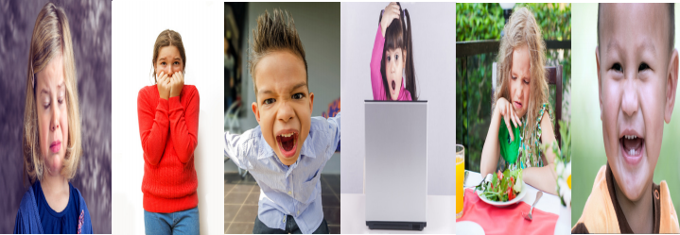

Why we need emotions
Emotions are universal, innate, hardwired for our survival
Distress Fear Anger Surprise Disgust Joy
“Learning, attention, memory, decision making and social functioning are both profoundly affected by and
subsumed within the processes of emotion.”
(Immordino-Yang and Damasio 2007:3)
Notes:
Many of the behaviours we observe will be controlled by emotions.
We are born with a number of basic emotions hardwired into us. The ones above are those generally recognised as innate. We can then develop up to 242 culturally dependent secondary emotions.
As you can see, most of the basic ones are negative – 5 to only 1 positive. That’s because we are hardwired for survival and the need to escape harm or danger. Those 5 negatives ones can all be experienced alone. However, joy nearly always comes from within a relationship, and it’s processed in a different part of the brain.
Of course, negative emotions can lead to positive things. Righteous anger can change the world – a sense of justice (fair/not fair) led to the end of slavery for instance. The sense of justice/fairness develops around the age of 18 months and is initially self-serving. Eventually its socially regulated through engagement with others – “I know you feel its not fair, but you need to share your toys”. Where no one socially regulates the feeling this sense of fairness remains self-serving and anger inducing.

Slide 14
What can we do?
The role of emotion coaching approaches.

Slide 15

What is Emotion Coaching?
Emotion Coaching is helping children to understand the different emotions they experience, why they occur and how to handle them.
Why do Emotion Coaching?
Emotion Coaching is an Evidence-based strategy.
Emotion-coached children:
Achieve more academically in school
Are more popular
Have fewer behaviour problems
Have fewer infectious illnesses
Are more emotionally stable
Are more resilient.
(Gottman et al. 1996)
Notes:
Emotion Coaching is an Evidence-based strategy based upon the work of John Gottman.
The approach “…helps to create nurturing relationships that scaffold the development of effective stress management skills, develop capacities to promote emotional and behavioural self-regulation and support pro-social behaviours (from Gus, et. al - abstract overview paper).
Underpinned by current theory and research from neuroscience, interpersonal neurobiology, developmental psychology and attachment theory.

Slide 16
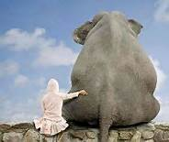
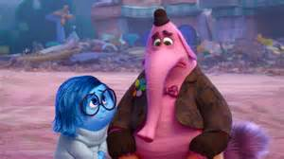
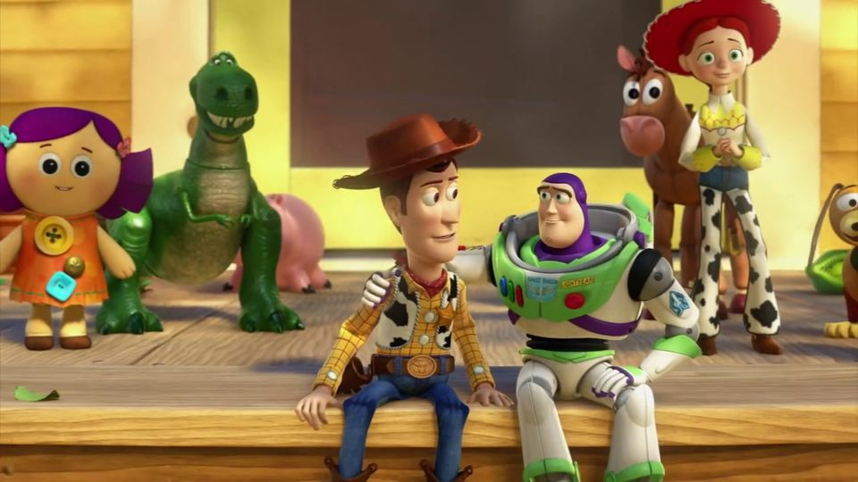
How to Emotion Coach
Step 1: Acknowledging the child’s feelings and empathising with them
Step 2: Validating the feelings and labelling them
Step 3: Setting limits on behaviour (if needed)
Step 4: Problem-solve with the child
Notes:
Step 1: Notice without judgement. Connect then redirect.
“Oh Emma I see you are crying”
Step 2: Use words to recognise (label), empathise and validate the feelings
“You look angry, am I right?. It’s ok to feel angry. It’s a normal feeling to have. I would feel angry too if I couldn’t have the toy I wanted”
Step 3: Set reasonable limits on behaviour
“I can see you’re angry but it’s not ok to throw that at me. I need to help you feel calm so you don’t hurt anything.
Problem solving
“I need to help you make things right again - what could we do?”
“Lets think how we could stop this from happening next time you’re angry”

Slide 17

Example 2:
Set limits
Notes:
Even though it’s important to validate your child’s feelings, you don’t have to validate their actions. Once you set a limit on inappropriate behaviour and its consequences, follow through and be consistent. The ideal time to use emotion coaching is right after your child misbehaves and before you deal out the consequence. For example, a parent might say, “You’re mad that Danny took that game away from you. I would be, too. But it’s not okay for you to hit him. What can you do instead?”

Slide 18
Restorative Approaches

Slide 19
Definition of Restorative Approaches
An approach to dealing with challenging behaviour and conflict
Focuses on building and repairing relationships
…rather than…
managing and controlling behaviour.
Which supports brain development – building brains through experiences.
Notes:
Remember the earlier slide where punishment v discipline were compared and discipline (teaching) is a restorative approach.
Restorative approaches are used in school …..

Slide 20
How does the restorative way work?
Those who are harmed are able to…
…have their story
heard
…be a part of
deciding what needs
to happen next
…have their hurt
mended and start
again
Those who cause harm are able to…
…take
responsibility
for their
actions
…reflect on
what they did
…understand
how their
actions affect
other people
…put things
right and
start again
Notes:
Remember the social engagement system (SES)– it picks up signals from others, such as body language, voice quality, and facial expressions. If the SES likes what it sees and hears, it calms us. The SES operates unconsciously, we are not aware that it is calming us. We have no idea that the SES is overriding stress hormones that other people almost constantly trigger in us.
The restorative approach helps us to feel socially connected, which supports the SES to calm us. When we feel calm, we can take in learning more effectively.

Slide 21
Social Discipline Window
HIGH
Punitive
Restorative
blame
empower
Control
(Limit Setting
Discipline)
        Neglectful
Permissive
ignore
excuse
LOW
Support
(Encouragement, Nurture)
HIGH
Blood, 2004
Adapted from Wachtel, 1999
Notes:
Low control – Low support =neglect (NOT doing anything)
High control – Low support = punishment (doing TO pupils)
Low control – High support = permissiveness (doing FOR the pupils)
High control – High support = restorative (working WITH the pupils)
Attributed to Ted Wachtel (iirp) & Paul McCold (criminologist - who has been involved in the evaluation of RP in the USA)
Point out two axes -
Vertical which can range from high to low is about rules, limit setting boundaries, parameters etc.
Horizontal - about support, encouragement, nurture etc
Swinging pendulum from punitive to permissive - give examples
Neglectful - nobody wants
Restorative - which is where we want people to be
This is NOT A NO BLAME APPROACH it’s about holding people accountable for their actions making them accept responsibility but supporting them in learning from what they have done to others - there are consequences to their actions both for themselves and others and helping them find a way of behaving differently next time.
21

Slide 22
Why do we need restorative practice?
It gives a voice to pupils who have been harmed
It helps develop pro-social behaviours such as empathy, responsibility, problem solving and understanding of consequences
It builds communities of care with relationships founded on trust and focused on support
It supports existing practice of making, maintaining and mending relationships

Slide 23
Characteristics of a Restorative Intervention
The aim is to:
Give the person a structured opportunity to learn to manage shame and/or take responsibility for their behaviour
Address any harm done
Reconcile damaged relationships
Consider how future problems can be avoided.
Notes:
P6 pupils demonstrate a ‘Restorative Conversation’
Education Scotland - RSW - RA Training

Slide 24

A Restorative Teacher's Point of View
Relationships matter
Better the relationships, better the learning
Fewer challenges and conflicts
Notes:
A restorative classroom is a place where relationships matter. The better the relationships in the classroom between teachers and students and between the students themselves, the better teachers can teach and the better the students can learn resulting in fewer challenges and conflicts there will be.

Slide 25
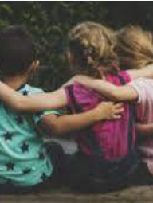
A Restorative Teacher's Point of View
Connections with each other and in learning
Notes:
We believe that relationships matter and creates opportunities for everyone in the class to connect as much as possible. To connect with what they know already, make connections between what others know, deepen their own understanding by deepening these connections and when things go wrong ensure that reconnection happens as soon as possible.

Slide 26
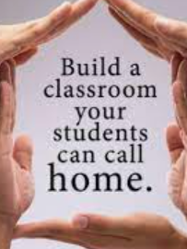
A Restorative Teacher's Point of View
Safer and happier = more receptive to learning
Stress and fear = reduces ability to process new information
Notes:
Relationships matter for effective teaching and learning. We know from experience that the safer and happier a child is the more receptive they are to new ideas and new learning. Put another way stress and fear reduces the ability to process new information. When our young people have strong social connections with their fellow students and their teachers they feel safer.

Slide 27
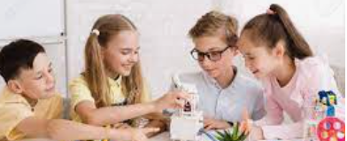
A Restorative Teacher's Point of View
Relationships matter for motivation and inspiration.
Notes:
Effective learning is all about making connections between what people already know and new knowledge and ideas. These connections can be made more effectively if children feel excited and inspired as well as engaged in their learning by being given opportunities to learn in their own way and to interact with others while sharing ideas to be challenged in creative ways.

Slide 28

A Restorative Conversation Example
Some of the pupils in Primary 6 have written and performed an example of a restorative conversation. The ideas and words come from their own experiences with this approach.

Slide 29
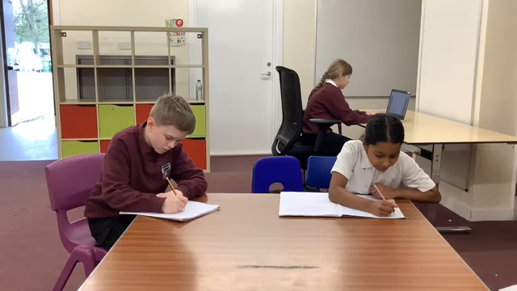
Restorative conversation

Slide 30
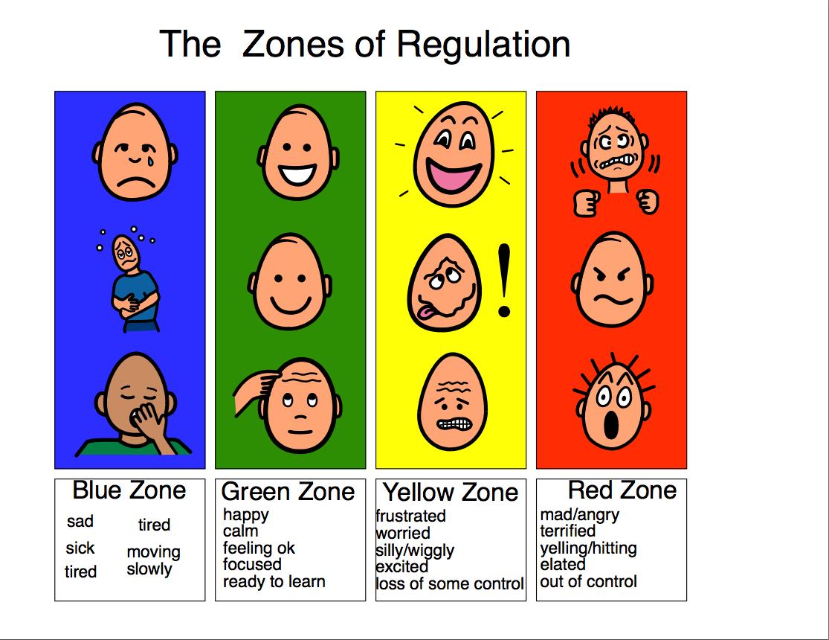
Zones of Regulation

Slide 31
Educational Psychology Service Website
Family nurture leaflets

Slide 32
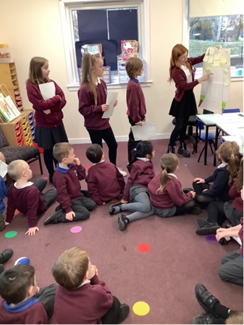

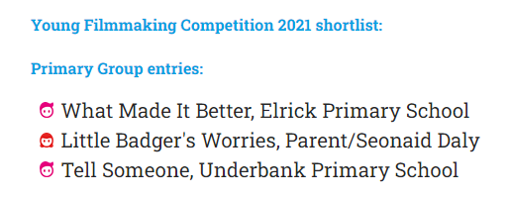
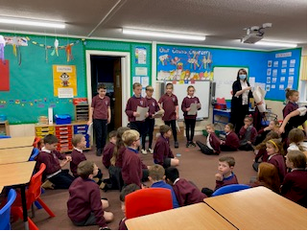
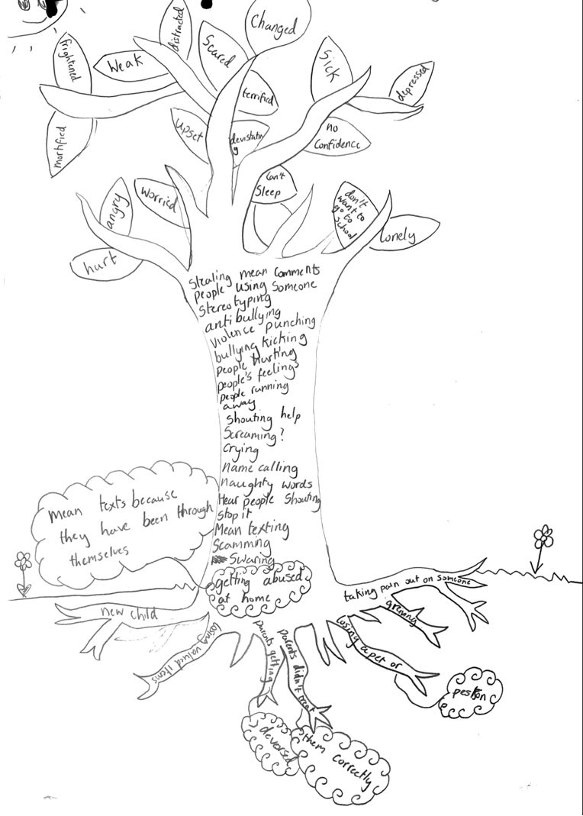
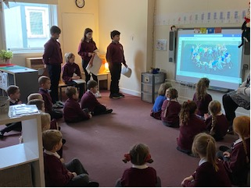
Respectme Young Filmmakers Competition and Anti-Bullying work from P6FA
Notes:
We entered the Young Filmmakers Competition to use it as a springboard to explore the behaviours and emotions of bullying. We started by using RespectMe’s “Tree of Understanding” in class to discuss and document triggers and causes of bullying behaviour, behaviours seen and experienced by children and impact of these behaviours on others. We also discussed differences between bullying behaviours and friends arguing or falling out.
We played with camera angles and how these are used for impact – especially illustrating power or feeling small. We looked at impact of colour and linked it to the emotional “Zones of Regulation” we have studied. Children chose shades of red to show bullying behaviours and blues to show upset and sadness. We discussed the impact of sound and silence and explored different human sounds alongside dialogue. We mapped the film frame by frame, discussing how to make impact on our audience. We wanted to highlight different bullying behaviours and impacts. We also wanted to stress how others can help children to make it better, drawing on the title of the project. We chose a heartbeat theme to accentuate the humanity behind bullying and create a dramatic feel. (show film)
We were delighted with the achievement of making the shortlist of the final three in the competition and we attended a virtual premiere event with respectme and the Scottish Government Cabinet Secretary for Education. We weren't selected as the winner but we are still proud to have been finalists.
We followed up our work by taking our film around all the classes at Elrick. The children led lessons on the tree of understanding with each class and went on to introduce this year's anti-bullying campaign.

