Slide 1
LITERACY PARENT WORKSHOP
April 2023

Slide 2
Objectives for tonight
Look at what we do in school to challenge and engage children in literacy.
Offer an opportunity for you to engage with activities related to how we teach grammar and writing.
Offer an opportunity for you to look at resources related to phonics that we use.
Allow time for questions and reflection.

Slide 3
Reading and Spelling
Reading is taught through:
Phonics
On entering P1 children begin to identify and sound out 44 phonemes. Sounds are introduced, to those children who are deemed ready to move on. Phonics is taught explicitly, in ability groups. We have developed our delivery of intensive phonics programme which builds on early learning in P1, to ensure that children will be well-placed to read and spell words with fluency and confidence by the time they reach the end of Year 7.
A phonics input lesson lasts for approx. 30 min when taught explicitly and reinforcement of a particular sound/sound family is undertaken during 20 minute slots in a fun way but also with rigor and pace.
Children’s phonological awareness and spelling strategies are assessed and the results of these assessments are used to inform planning and teaching.

Slide 4
Story time
Whole class reading that develops listening skills, a love of story and reading for pleasure.
This is teacher led reading, with children listening and responding to questions, predictions and vocabulary choices, as appropriate to the level of the children.
Shared/Guided reading that immerses children in the pattern of story and features of text types.
This happens in English lessons when introducing text and prior to writing. The teacher models as an expert reader and draws out the key elements of the content - MAKING SPECIFIC REFERENCE TO INFERENCE, PREDICTION AND SUMMARY.
Whole Class Shared Reading that targets children’s reading skills.

Slide 5
Independent reading in school and at home.
Books are sent home with a reading record or organiser for communication with parents. Oxford Reading tree is the main core scheme.
From Foundation Stage (Pink Band 1) up to Lime Band 11. Children take home a core scheme book that is monitored and changed regularly by an adult in school.
Children are encouraged to read regularly at home – at least three times a week.

Slide 6
COMPREHENSION LESSONS AND VIPERS
Comprehension lessons take place weekly across the school.
They involve not just story texts but non-fiction, song lyrics, play scripts and short animated films.
They focus children on the text level that is just above their reading age as their understanding of it is supported in the class.
They are also grouped according to the strand of questioning that they need to focus on the most.
The biggest challenges are answering vocab, inference and prediction questions.

Slide 7
Classroom Reading Corners
Warm and inviting spaces to go and read.
Linked to topics.
Interactive.
Change regularly.
Have Books of the week/ identified good reads.
Include non fiction books, poetry, classic literature, challenging texts and abridged versions of stories that children can access. Many longer books are not being loaned from the library or taken off the shelves.

Slide 8
SCHOOL LIBRARY
We have a team of Parent Volunteers who have worked each week since September alongside Mrs Ford to get the Library looking fit for purpose.
They have removed out of date and damaged books and redistributed books into class libraries where the section has no more room left or we have multiple copies.
The children have the opportunity to visit the library at least once a wee with their class.
Children can only borrow one book at a time.

Slide 9
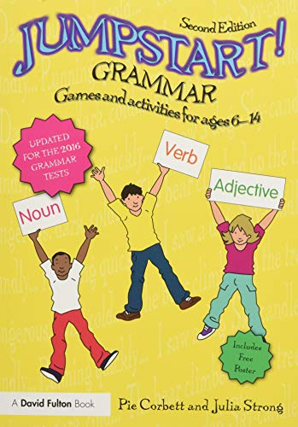
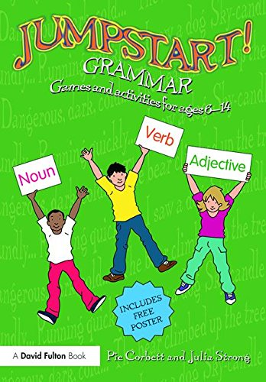
Grammar
Grammar is taught weekly and reinforced during writing and comprehension sessions.
Each lesson includes: playing a game (related to concept), input (including songs) and a consolidation worksheet.

