Slide 1
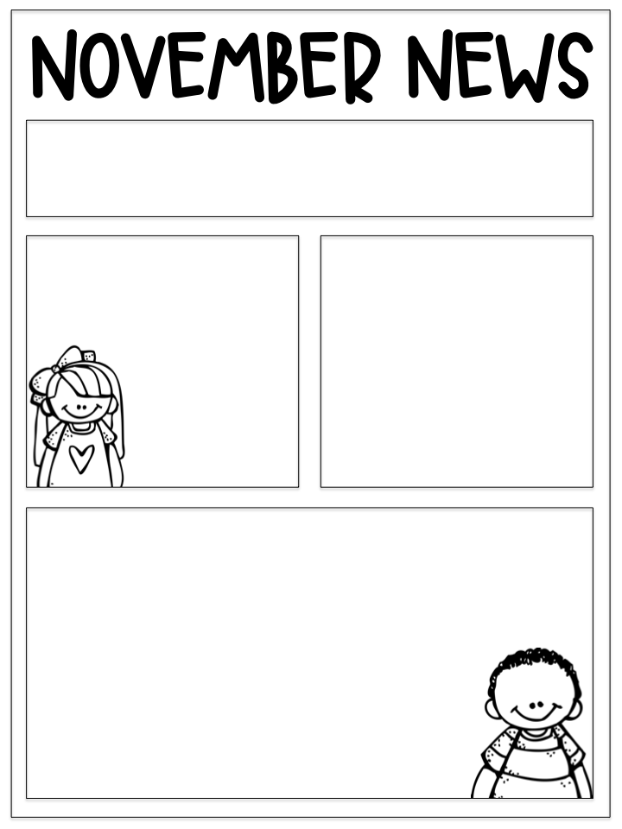
We are
Important dates:
Thursday 17th & Friday 18th November: Inservice days – school and nursery closed to all pupils
Sunday 4th December: Christmas fayre
Wednesday 14th December – Christmas lunch and Christmas jumper day
Tuesday 20th December – Christmas party
Friday 23rd December – Occasional day – school and nursery closed.
kind
respectful
& safe
Timetable:
Monday, Tuesday, Thursday, Friday: Miss Ingram
Wednesday: Mrs Coles
Monday: Homework due, P.E
Tuesday: Music, Art
Wednesday: Assembly, Homework set
Friday: P.E
You can support your child by:
Reading together and encouraging them to explore a wide variety of texts.
Sharing news and current events. Newsround is a useful programme to watch together.
Practising maths using games, particularly multiplication and division.
Encouraging your child to organise themselves by bringing all necessary equipment to school as needed including homework.
Please ensure children have a jacket every day (even if the weather looks good). We will aim to be outside each day unless the weather is too bad. Children have access to the field at break and lunch which can get very muddy so a full change of clothes in school bags would be handy for pupils to have.
This term we will be taking part in wellbeing Wednesday, an initiative developed by our Health Heroes. On Wednesdays we will be looking at the meaning of good health, the wellbeing across our school, how we can improve fitness and how we can improve mental health. We will all be taking part in ‘Fifteen Minute Fitness’ and ‘Mental Health Moments’.
Literacy
This term we have started ‘Talk for Writing’, this project teaches writing across three stages;
Imitation, where pupils learn and internalise texts, to identify transferrable ideas and structures,
Innovation, where pupils use these ideas and structures to co-construct new versions with their teachers,
Invention, where teachers help pupils to create original texts independently
These tasks aim to improve writing ability by giving pupils an understanding of the structure and elements of written language. Throughout our writing we will be reviewing spelling and grammar.
This term we are reading in small groups with a focus on reading with fluency and expression. We will not be sending reading books home however we encourage children to explore different texts independently and with family members.
Maths
This term we are consolidating our addition and subtraction strategies after which we will be moving on to multiplication and division. You can support your child with this at home by helping them practise or by playing multiplication and division games such as those on the website Top Marks.
Learning Across the Curriculum
This term we will be looking at traditions
and celebrations in different places
and religions around the world.
We will also be conducting
our own science experiments every
week to explore and develop our
understanding of chemicals and
substances.

